Slide 1
ESYS-FINAL
TAKEAWAY
李俊廷、施冠宇、洪世昌

Slide 2
MOTIVATION:
Foopanda, uber eat often mess our orders.
Accident might happen to an elder who has no cell phone by herside.

Slide 3
IMPLEMENTATION
Send a gps data when there is an accident happened.
GPS module(neo-6m) & STM32L4 accelerometer
When an abnormal high acceleration on bike or motorbike sensed by the stm32,
=>It will send a gps data(NMEA $GPRMC) to a webpage to let the customer knows.

Slide 4
GPS:
GPRMC DATA:
data format:($GPRMC,<1>,<2>,<3>,<4>,<5>,<6>,<7>,<8>,<9>,<10>,<11>)
<1>Time
<2>Valid
<3>Longitude
<5>Latitude

Slide 5
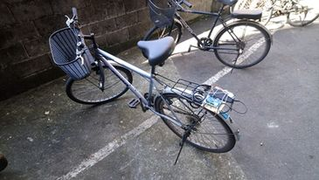
Data Analysis
蒐集並分析正常、急煞、轉彎、滑動、蛇行、傾斜等騎乘方式的加速度資料，判斷駕駛是否正常行駛。

Slide 6
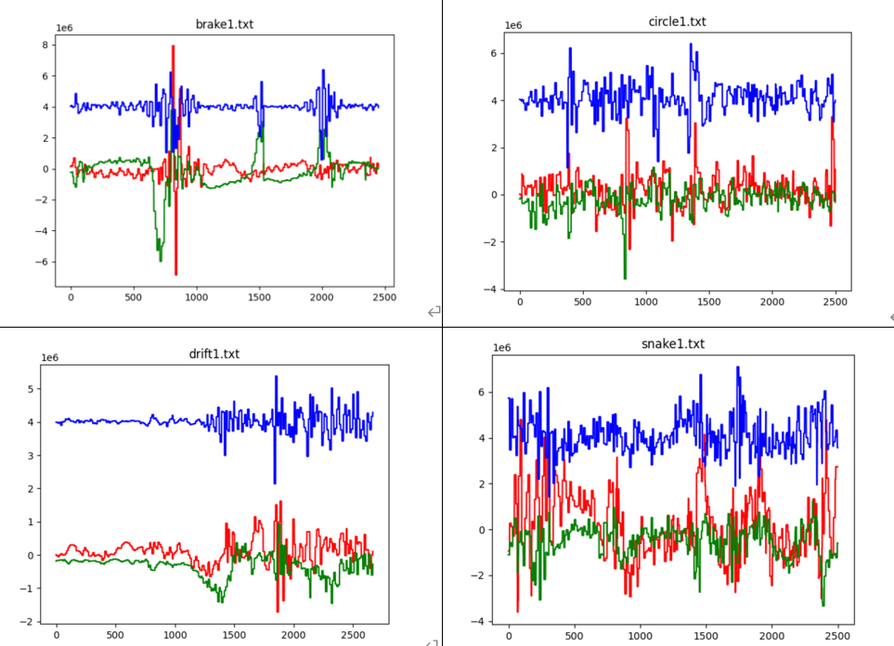

Slide 7
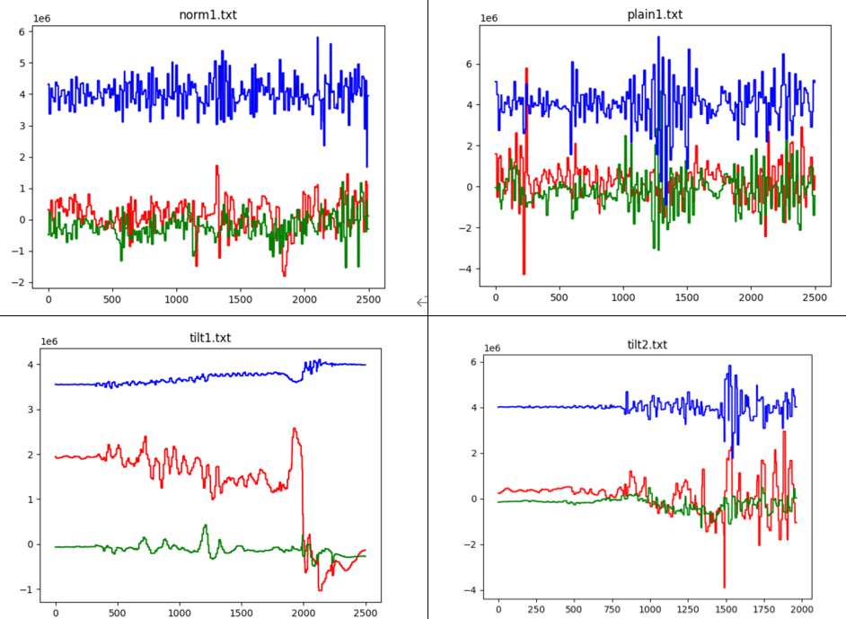

Slide 8
Fuzzy Classification
建立大小為80（約1s）的buffer，紀錄一秒內的加速度大小。
Axi表示為x軸加速度統計量所對應之歸屬函數程度，並將其畫分為 L=Low 、 M=Medium、H=High。而 i 分別代表為加速度大小H=(+1, inf)、M=(-1, +1)、L=(-inf, -1)。
Ayi, Azi同理。

Slide 9
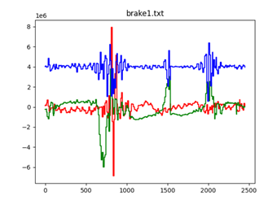
Data Processing
使用fuzzy classification為每項騎乘方式分類。透過 x 軸、y 軸及 z軸的加速度值來決定其加速度的統計量，並設定模糊規則作為模糊分類器的規則庫。
for example, Rule1:
If ((AxM is L) or ((AxH is M) and (AxL is M)))
and (AyL is L)
and ((AzH is M) and (AzL is M))
then (G is Brake)

Slide 10
Data Transmit
透過wifi，在終端(mbed)建立socket client，將資料傳送給socket server(電腦)。為降低耗能，終端只在有不當駕駛行為時傳送通知，內容包含行駛方式與當前GPS定位。

Slide 11
Webpage
顯示外送員在外送過程中加速度超標的地點
利用GPS定位出經緯度，再利用 google map 顯示出位置

Slide 12
Webpage Implementation
Python socket
Html file
Write the received data from stm32 into html file, web server then transfer the data required from the client to the web page

Slide 13
Issue to be solved:
Start up acceleration value is not precise
Gps data might take a while for TTFF
Gps signal is too weak indoor for neo-6m

Slide 14
REFERENCE:
https://os.mbed.com/teams/mbed-os-examples/code/mbed-os-example-mbed5-wifi//annotate/86dca48315d8/main.cpp/
http://aprs.gids.nl/nmea/
https://os.mbed.com/users/nliu96/code/GPS-Library/
基於加速度特徵值之模糊手勢識別系統
http://163.17.20.49/IJAIT/IJAIT%207(2)/IJAIT%207(2)_09.pdf

Slide 15
DEMO:
https://youtu.be/iPRQWVrca58
https://youtu.be/Oq1QwztKsbk
https://youtu.be/C6c5yXrH1KQ

